Slide 1

Clicker Questions
Chapter 10
Liquids, Solids, and Phase Changes
Donald Linn
Indiana University–
Purdue University Fort Wayne
Fort Wayne, IN

Slide 2
Which covalent bond is the most polar?
a) N–F
b) C–F
c) Cl–F
d) F–F
e) None of the above
Notes:
Answer: b

Slide 3
Which covalent bond is the most polar?
a) N–F
b) C–F
c) Cl–F
d) F–F
e) None of the above
Notes:
Answer: b

Slide 4
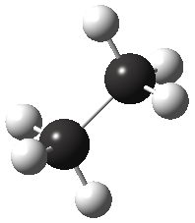
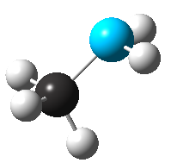
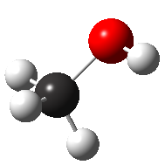
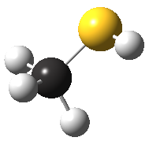
Which of the following molecules would you expect to be the most polar?
N
O
S
N
a)
b)
c)
d)
Notes:
Answer: c

Slide 5
Which of the following molecules would you expect to be the most polar?
N
O
S
N
a)
a)
b)
b)
c)
d)
d)
Notes:
Answer: c

Slide 6
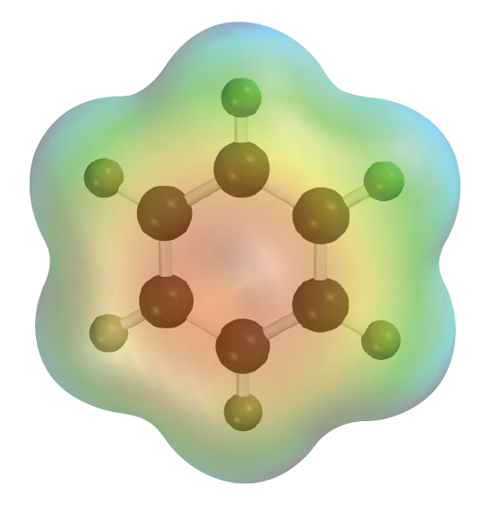
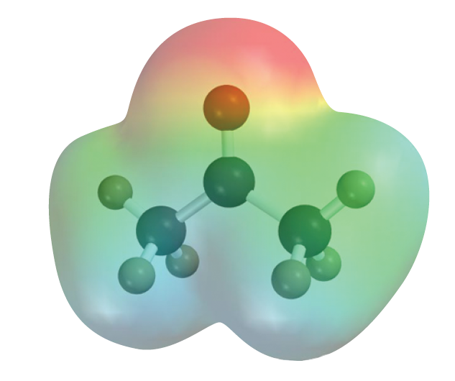
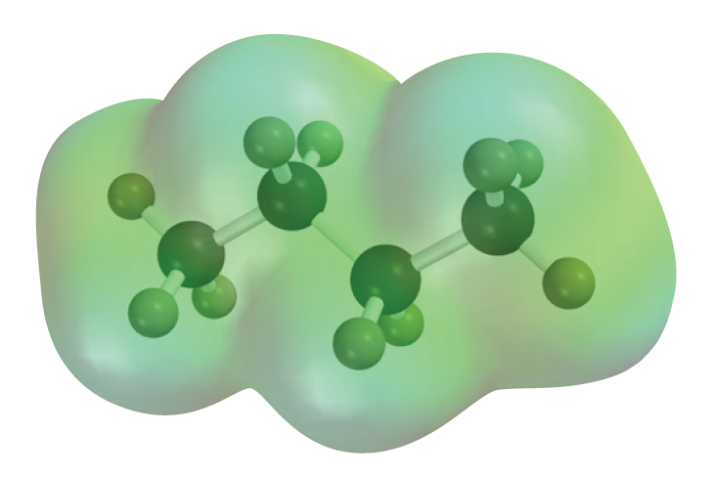
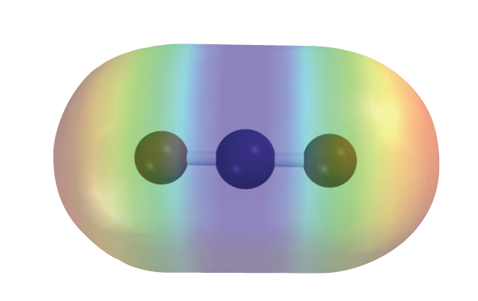
Which of the following do you think might have the strongest intermolecular forces?
a) CO₂
b) C₆H₆
c) C₃H₆O
d) C₄H₁₀
Notes:
Answer: c

Slide 7
Which of the following do you think might have the strongest intermolecular forces?
a) CO₂
b) C₆H₆
c) C₃H₆O
d) C₄H₁₀
Notes:
Answer: c

Slide 8
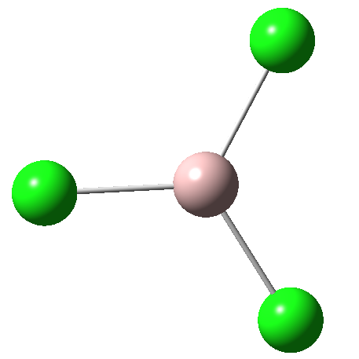
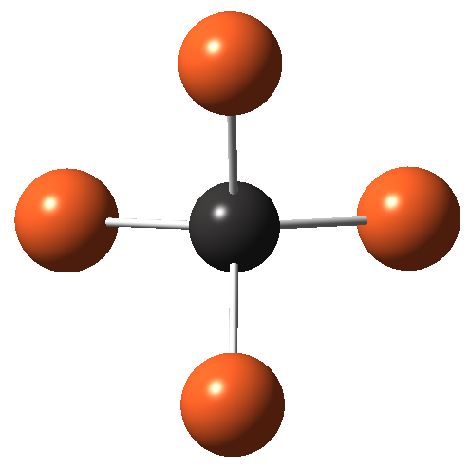
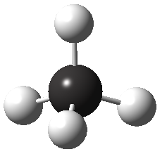
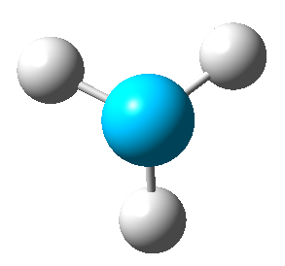
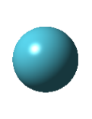
In which of the following are London dispersion forces not the only forces at play?
a) Kr
b) CH₄
c) NH₃
d) AlCl₃
e) CBr₄
Notes:
Answer: c

Slide 9
In which of the following are London dispersion forces not the only forces at play?
a) Kr
b) CH₄
c) NH₃
d) AlCl₃
e) CBr₄
Notes:
Answer: c

Slide 10
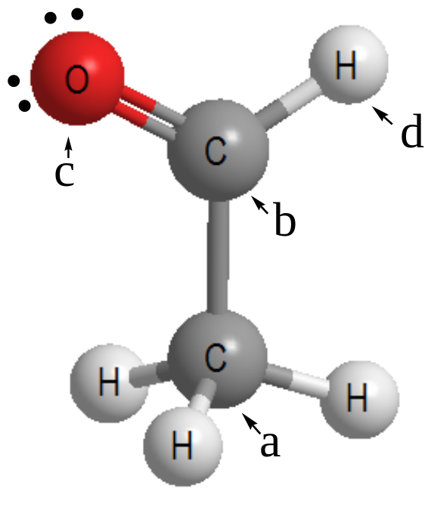
In the drawing of acetaldehyde, CH₃CHO, the largest partial positive charge ( δ+) occurs on
a) atom (a).
b) atom (b).
c) atom (c).
d) atom (d).
e) None of the above
Notes:
Answer: b

Slide 11
In the drawing of acetaldehyde, CH₃CHO, the largest partial positive charge ( δ+) occurs on
a) atom (a).
b) atom (b).
c) atom (c).
d) atom (d).
e) None of the above
Notes:
Answer: b

Slide 12
The HI bond has a length of 161 pm and 4.92% ionic
character. What is the experimental dipole moment
of HI?
a) 0.380 D
b) 0.772 D
c) 3.80 D
d) 7.72 D
e) None of the above
Notes:
Answer: a

Slide 13
The HI bond has a length of 161 pm and 4.92% ionic
character. What is the experimental dipole moment
of HI?
a) 0.380 D
b) 0.772 D
c) 3.80 D
d) 7.72 D
e) None of the above
Notes:
Answer: a

Slide 14
The dipole moment of BrF is 1.29 D, and its bond length is 178 pm. What is the percent ionic character of the Br–F bond?(Hint: q_{elec} = 1.6 × 10^{–19}; 1 D = 3.3 × 10^{–30} C m.)
a) 3.9%
b) 8.5%
c) 15%
d) 33%
e) None of the above
Notes:
Answer: c

Slide 15
The dipole moment of BrF is 1.29 D, and its bond length is 178 pm. What is the percent ionic character of the Br–F bond?(Hint: q_{elec} = 1.6 × 10^{–19}; 1 D = 3.3 × 10^{–30} C m.)
a) 3.9%
b) 8.5%
c) 15%
d) 33%
e) None of the above
Notes:
Answer: c

Slide 16
The vapor pressure of liquid chloroform, CHCl₃, is
400.0 torr at 24.1 °C and 100.0 torr at –6.3 °C. What is ΔH_{vap} for chloroform?
a) 15. kJ/mol
b) 30. kJ/mol
c) 58. kJ/mol
d) 87. kJ/mol
e) None of the above
Notes:
Answer: b

Slide 17
The vapor pressure of liquid chloroform, CHCl₃, is
400.0 torr at 24.1 °C and 100.0 torr at –6.3 °C. What is ΔH_{vap} for chloroform?
a) 15. kJ/mol
b) 30. kJ/mol
c) 58. kJ/mol
d) 87. kJ/mol
e) None of the above
Notes:
Answer: b

Slide 18
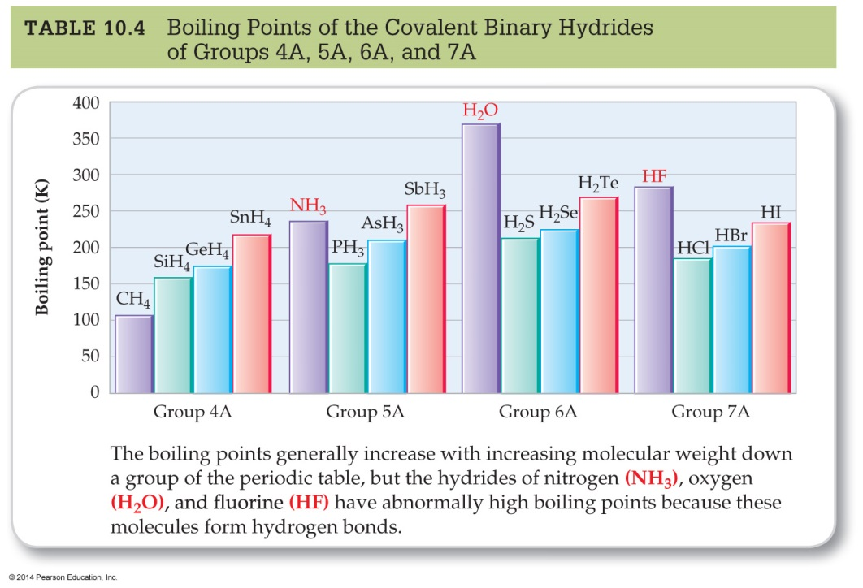
Which of the following
statements is true?
a) Due to its greater polarizability, NH₃ has a higher boiling point
than CH₄.
b) HF has a higher boiling
point than HCl because
it has a stronger dipole moment.
c) Water has a higher boiling point than HF because it is more polar.
d) SbH₃ has a higher boiling point than NH₃ because it has more polar bonds.
e) The H–Cl bond is weaker than the H–Br bond, therefore HBr has a higher boiling point.
Notes:
Answer: b

Slide 19
Which of the following
statements is true?
a) Due to its greater polarizability, NH₃ has a higher boiling point
than CH₄.
b) HF has a higher boiling
point than HCl because
it has a stronger dipole moment.
c) Water has a higher boiling point than HF because it is more polar.
d) SbH₃ has a higher boiling point than NH₃ because it has more polar bonds.
e) The H–Cl bond is weaker than the H–Br bond, therefore HBr has a higher boiling point.
Notes:
Answer: b

Slide 20

Which of the following statements is false?
a) Water has a high heat of vaporization due to its very strong intermolecular forces.
b) The heat of vaporization of water is probably higher than that of methanol.
c) The intermolecular forces that are responsible for H₂O being mainly liquid between 273 and 373 K are hydrogen bonding and dispersion forces.
d) Dodecane (C₁₂H₂₅) has a boiling point of 490 K, therefore it must have stronger hydrogen bonds
than water.
Notes:
Answer: d

Slide 21
Which of the following statements is false?
a) Water has a high heat of vaporization due to its very strong intermolecular forces.
b) The heat of vaporization of water is probably higher than that of methanol.
c) The intermolecular forces that are responsible for H₂O being mainly liquid between 273 and 373 K are hydrogen bonding and dispersion forces.
d) Dodecane (C₁₂H₂₅) has a boiling point of 490 K, therefore it must have stronger hydrogen bonds
than water.
Notes:
Answer: d

Slide 22
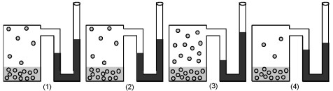
If figure (1) represents the vapor pressure of water at 25 °C, which figure represents the vapor pressure of ethanol, CH₃CH₂OH at 25 °C?
a) Figure (2)
b) Figure (3)
c) Figure (4)
d) All are equivalent.
e) None of the above
Notes:
Answer: b

Slide 23
If figure (1) represents the vapor pressure of water at 25 °C, which figure represents the vapor pressure of ethanol, CH₃CH₂OH at 25 °C?
a) Figure (2)
b) Figure (3)
c) Figure (4)
d) All are equivalent.
e) None of the above
Notes:
Answer: b

Slide 24
If figure (1) represents the vapor pressure of diethyl ether, CH₃CH₂OCH₂CH₃, at 25 °C, which figure represents the vapor pressure of ethanol at 25 °C?
a) Figure (2)
b) Figure (3)
c) Figure (4)
d) All are equivalent.
e) None of the above
Notes:
Answer: c

Slide 25
If figure (1) represents the vapor pressure of diethyl ether, CH₃CH₂OCH₂CH₃, at 25 °C, which figure represents the vapor pressure of ethanol at 25 °C?
a) Figure (2)
b) Figure (3)
c) Figure (4)
d) All are equivalent.
e) None of the above
Notes:
Answer: c

Slide 26
Which is classified as an amorphous solid?
a) Palladium(II) chloride
b) Sodium hexaflurophosphate
c) Polyethylene (plastic)
d) Platinum
e) None of the above
Notes:
Answer: c

Slide 27
Which is classified as an amorphous solid?
a) Palladium(II) chloride
b) Sodium hexaflurophosphate
c) Polyethylene (plastic)
d) Platinum
e) None of the above
Notes:
Answer: c

Slide 28
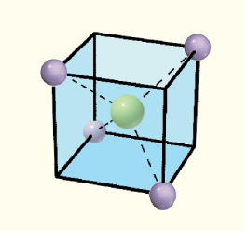
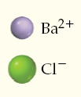
Shown is a unit cell for barium chloride. How many barium and chloride ions are there in each unit cell?
a) 1 Ba²⁺, 4 Cl–
d) 1 Ba²⁺, 1 Cl–
b) 4 Ba²⁺, 1 Cl–
e) 0.5 Ba²⁺, 1 Cl–
c) 2 Ba²⁺, 1 Cl–
Notes:
Answer: e

Slide 29
Shown is a unit cell for barium chloride. How many barium and chloride ions are there in each unit cell?
a) 1 Ba²⁺, 4 Cl–
d) 1 Ba²⁺, 1 Cl–
b) 4 Ba²⁺, 1 Cl–
e) 0.5 Ba²⁺, 1 Cl–
c) 2 Ba²⁺, 1 Cl–
Notes:
Answer: e

Slide 30
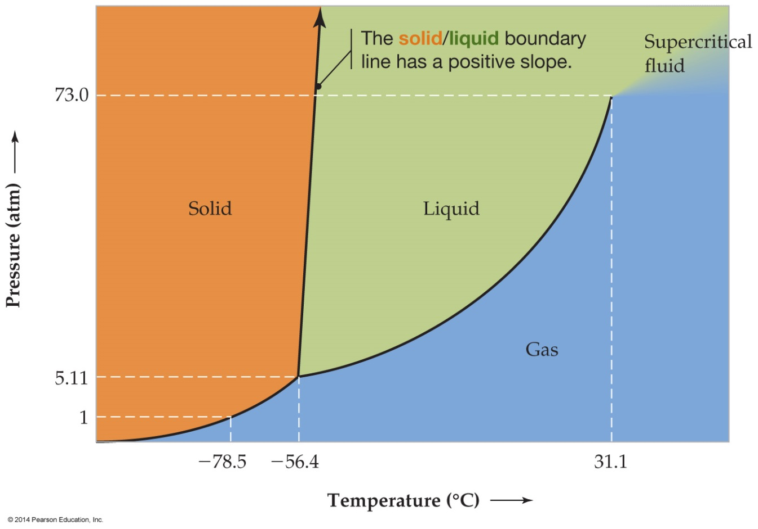
What are the phase changes represented by the path in the phase diagram shown?
a) s l g s
b) l s g l
c) g l s g
d) s g l s
e) l g s l
Notes:
Answer: a

Slide 31
What are the phase changes represented by the path in the phase diagram shown?
a) s l g s
b) l s g l
c) g l s g
d) s g l s
e) l g s l
Notes:
Answer: a

Slide 32
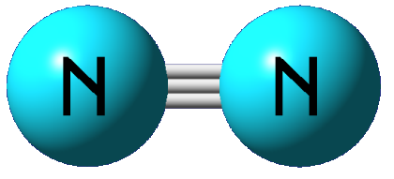
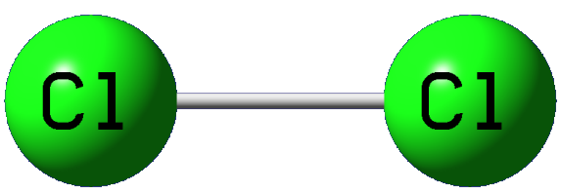
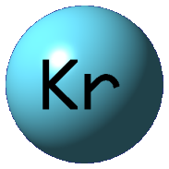
Which of the following substances would you expect to have a higher boiling point?
a)
b)
c)
d)
None can be liquids.
e)
Cannot be determined
Notes:
Answer: b

Slide 33
Which of the following substances would you expect to have a higher boiling point?
a)
b)
c)
d)
None can be liquids.
e)
Cannot be determined
Notes:
Answer: b

Slide 34
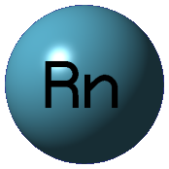
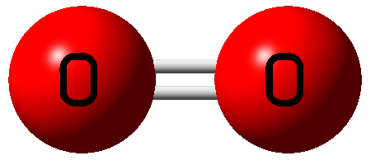
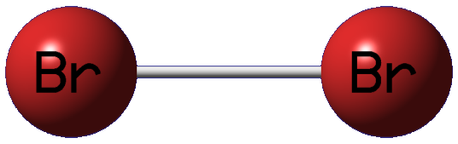
Which of the following substances would you expect to have a higher boiling point?
a)
b)
c)
d)
None can be liquids.
e)
Cannot be determined
Notes:
Answer: c

Slide 35
Which of the following substances would you expect to have a higher boiling point?
a)
b)
c)
d)
None can be liquids.
e)
Cannot be determined
Notes:
Answer: c

Slide 36
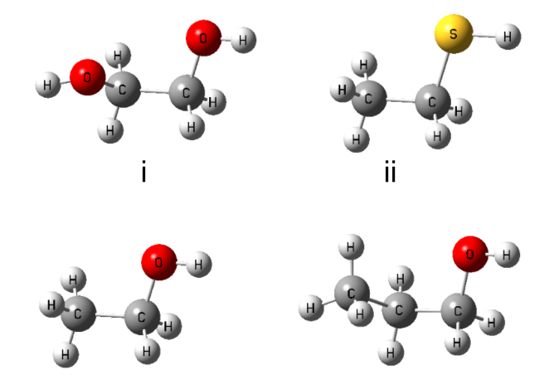
Which of the following has the lowest vapor pressure?
a)
b)
c)
d)
e) Cannot be determined
Notes:
Answer: a

Slide 37
Which of the following has the lowest vapor pressure?
a)
b)
c)
d)
e) Cannot be determined
Notes:
Answer: a

Slide 38
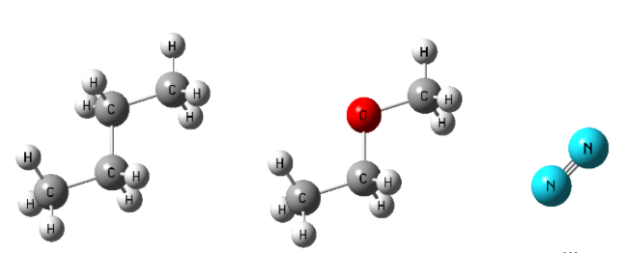
Which of the following has the lowest vapor pressure?
a)
b)
c)
d) All the same
e) Cannot be determined
Notes:
Answer: b

Slide 39
Which of the following has the lowest vapor pressure?
a)
b)
c)
d) All the same
e) Cannot be determined
Notes:
Answer: b

Slide 40
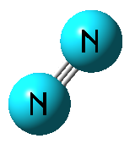
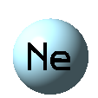


Which of the following substances would you expect to have the highest boiling point?
a)
b)
c)
d)
e) Cannot be determined
Notes:
Answer: d

Slide 41
Which of the following substances would you expect to have the highest boiling point?
a)
b)
c)
d)
e) Cannot be determined
Notes:
Answer: d

Slide 42
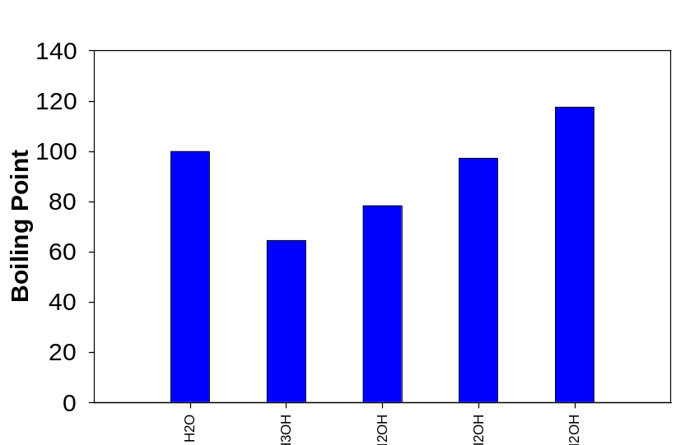
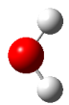
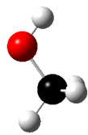
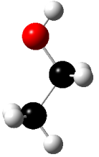
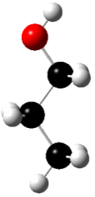
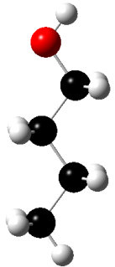
The intermolecular force responsible for the increase in the boiling points of alcohols with increasing carbon atoms is
a) hydrogen bonding.
b) dipole–dipole bonding.
c) dispersion forces.
d) carbon–carbon covalent bonding.
e) ion–dipole forces.
Notes:
Answer: c

Slide 43
The intermolecular force responsible for the increase in the boiling points of alcohols with increasing carbon atoms is
a) hydrogen bonding.
b) dipole–dipole bonding.
c) dispersion forces.
d) carbon–carbon covalent bonding.
e) ion–dipole forces.
Notes:
Answer: c

Slide 44
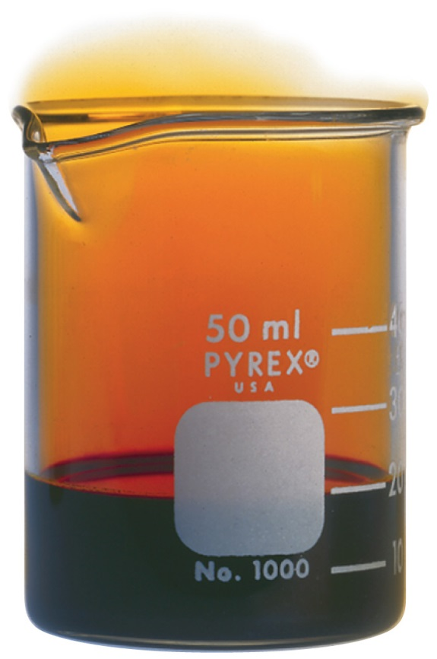
Which of the following is true pertaining to the difference between bromine in the liquid and the vapor phase?
a) The vapor molecules have weaker intermolecular forces than those in the liquid phase.
b) The molecules in the vapor phase have enough kinetic energy to overcome the intermolecular forces.
c) The vapor is composed of bromine atoms rather than Br₂ and so have weaker dispersion forces.
d) There is no difference in vapor pressure in liquid versus gaseous Br₂.
e) None of the above
Notes:
Answer: b

Slide 45
Which of the following is true pertaining to the difference between bromine in the liquid and the vapor phase?
a) The vapor molecules have weaker intermolecular forces than those in the liquid phase.
b) The molecules in the vapor phase have enough kinetic energy to overcome the intermolecular forces.
c) The vapor is composed of bromine atoms rather than Br₂ and so have weaker dispersion forces.
d) There is no difference in vapor pressure in liquid versus gaseous Br₂.
e) None of the above
Notes:
Answer: b

Slide 46
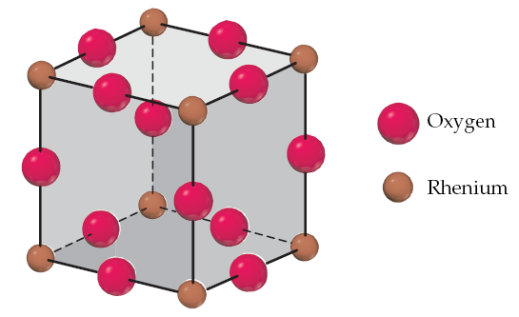
Rhenium oxide crystallizes in the cubic unit cell below.
What is the oxidation state of Rh in rhenium oxide?
a) 1
d) 4
b) 2
e) 6
c) 3
Notes:
Answer: e

Slide 47
Rhenium oxide crystallizes in the cubic unit cell below.
What is the oxidation state of Rh in rhenium oxide?
a) 1
d) 4
b) 2
e) 6
c) 3
Notes:
Answer: e

Slide 48
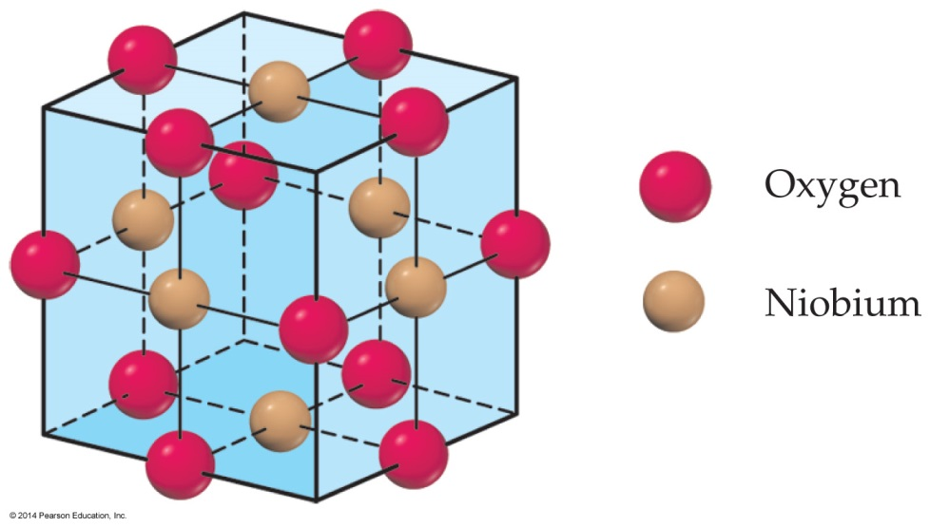
Niobium oxide crystallizes in the unit cell to the right.
What is the chemical formula for niobium oxide?
a) NbO
d) Nb₃O₂
b) Nb₂O
e) Nb₂O₃
c) NbO₂
Notes:
Answer: a

Slide 49
Niobium oxide crystallizes in the unit cell to the right.
What is the chemical formula for niobium oxide?
a) NbO
d) Nb₃O₂
b) Nb₂O
e) Nb₂O₃
c) NbO₂
Notes:
Answer: a

